Slide 1



Exercise Before & After Weight Loss Surgery
          Colette Micko, M.S, RD, CDE
          Bariatric Wellness Program Coordinator
Notes:
Hi- Welcome to our nutrition support group lecture series. My name is Colette Micko and I am the Providence Little Company of Mary Bariatric Wellness Program Coordinator. I am also a registered dietitian and certified diabetes educator. Today we will be covering the topic of exercise before and after weight loss surgery.

Slide 2

Project analysis slide 2
Overview of Presentation
Benefits of regular exercise pre-operatively
Benefits of regular exercise post-operatively
Physical activity guidelines
The basics for developing an exercise plan
Notes:
Today’s we’ll be covering the topic of exercise and giving some general guidelines and the “How tos” of starting an exercise plan.

Slide 3

Project analysis slide 2
Exercise & Weight Loss Surgery
Developing and maintaining a consistent exercise program helps to strengthen your heart, bones, muscles, increase your metabolic rate (thus burning more calories), improves mood and relieves stress
Exercise can also help to improve insulin sensitivity, resulting in better blood sugar control
Regular exercise is key to helping you lose weight, and more importantly KEEPING IT OFF.
Exercise is an important component pre/post wt. loss surgery
Notes:
Excess body weight (particularly fat around the liver) increases surgical risk during upper abdominal laparoscopic surgery such as sleeve and bypass.
Research shows behavior changes related to diet and exercise that are made preoperatively, increase success rates after surgery.

Slide 4
Project analysis slide 2
Exercise Pre-Operatively
Benefits of pre-operative exercise regimen
  Research suggests that patients who exercise regularly prior to surgery have a faster recovery and lower complication rate than those who do not.
  Anatomical improvements that allow for an easier surgical course (reduced fat cells in the liver and abdomen).
  Helps make transition to post-operative lifestyle easier
Notes:
How much you exercise will be a determinant factor in those that maintain their weight loss long term. Therefore, it is strongly encouraged to exercise prior to WLS to prepare yourself for the lifestyle changes after. Additionally, many surgeons have a pre-operative weight loss requirement, and exercise can play a key role in increase energy expenditure throughout the day.
The American College of Sports Medicine’s recommendations for for weight loss are to get at up to 250 minutes per week. This is five 50 minute exercise sessions per week (althought you can distribute the exercise sessions however best fits your schedule). If are just getting started and feel intimidated by the recommendations- remember that some exercise is better than no exercise. Even just sitting less throughout the day can help to improve overall health- so try simple things like short walks after meals, taking that stairs, or parking further away.
If joint issues are a problem, try water aerobics, swimming or arm bike.
Just remember, consistency is key (missing one day here and there won’t make or break you).
Patient that lose weight before surgery and exercise regularly literally reduce liver size and amount of fat stored in abdomen- making it an easier and faster surgery with less incisions (less incisions typically means less pain).

Slide 5

Project analysis slide 2
Exercise Post-Operatively
Benefits of post-operative exercise regimen
  Regular walking is an essential part of recovery in the first few weeks after surgery
  Once cleared for exercise by your surgeon, exercise will be essential to helping you MAINTAIN your weight loss
  Helps prevent lean muscle mass loss
  Positive coping mechanism for stress
Notes:
How much you exercise will be a determinant factor in those that maintain their weight loss long term. Therefore, it is strongly encouraged to exercise prior to WLS to prepare yourself for the lifestyle changes after. Additionally, many surgeons have a pre-operative weight loss requirement, and exercise can play a key role in increase energy expenditure throughout the day.
The American College of Sports Medicine’s recommendations for for weight loss are to get at up to 250 minutes per week. This is five 50 minute exercise sessions per week (although you can distribute the exercise sessions however best fits your schedule). If are just getting started and feel intimidated by the recommendations- remember that some exercise is better than no exercise. Even just sitting less throughout the day can help to improve overall health- so try simple things like short walks after meals, taking that stairs, or parking further away.
If joint issues are a problem, try water aerobics, swimming or arm bike.
Just remember, consistency is key (missing one day here and there won’t make or break you).
Patient that lose weight before surgery and exercise regularly literally reduce liver size and amount of fat stored in abdomen- making it an easier and faster surgery with less incisions (less incisions typically means less pain).

Slide 6
Project analysis slide 2
Recommendations
Physical activity recommendations
  Type: Optimal for weight loss=cardio + weight training
  Duration
    Weight loss: ~250 minutes per week (five 50 minutes sessions/week)
    Weigh maintenance: ~150 minutes per week (five 30 minutes sessions/week)

Slide 7

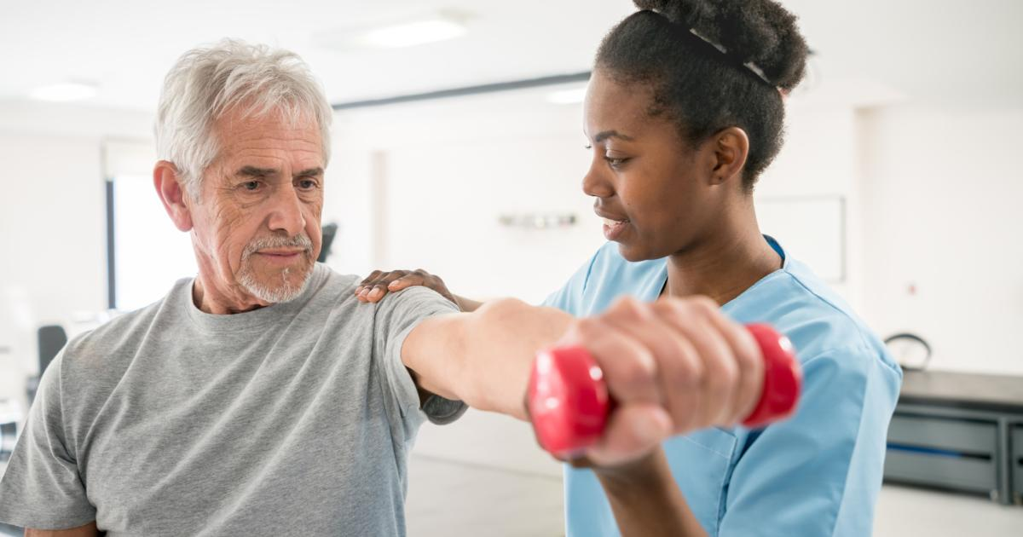

Project analysis slide 2
Recommendations
Most importantly:
  Find an exercise you enjoy and stick with it
  Remember that some activity is better than zero activity
  Start small and work your way up to recommended guidelines

Slide 8
Project analysis slide 2
Developing an Exercise Plan
While moderate physical activity such as walking is safe for most people, talk to your doctor before starting an exercise program if you have a history of:
    Heart disease
    Diabetes
    Kidney disease
    Arthritis
    High blood pressure

Slide 9
Project analysis slide 2
Developing an Exercise Plan
Exercise plan basics:
  Find an exercise partner. You are more likely to stick with a plan if you have an accountability partner.
  Try different activities and stick with the one you enjoy the most.
  Walk as often as you can.
  Create a fun/motivational playlist.
  Make sure you have comfortable workout clothes and shoes.
  Create a weekly plan/goals for the week. Find ways to incorporate activity into you schedule daily.

Slide 10
Thank You

