Slide 1
LABEL READING BASICS
Colette Micko, MS, RD, CDE
Bariatric Wellness Program Coordinator
Notes:
Hi- Welcome to our nutrition support group lecture series. My name is Colette Micko and I am the Providence Little Company of Mary Bariatric Wellness Program Coordinator. I am also a registered dietitian and certified diabetes educator. Today we will be covering the topic of Label Reading. This is meant to serve as a brief overview/understanding of “How to Read a food label” to help you as the consumer, make healthier food choices and meet your long term health goals.

Slide 2
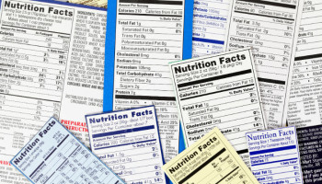
Project analysis slide 2
Overview of Presentation
Review components of a food labels
How to read the nutrition facts label
How we can use this information to make informed choices
Notes:
When it comes to including more healthy foods in your diet, fresh fruits and vegetables are a slam dunk. But including prepackaged foods can be trickier, especially after bariatric surgery. However, it is impossible to learn how to use the Nutrition Facts on the package to make an informed decision about whats incide. The vitamin or mineral content is less important as a basis for buying a product unless everything else adds up to a healthy choice.

Slide 3
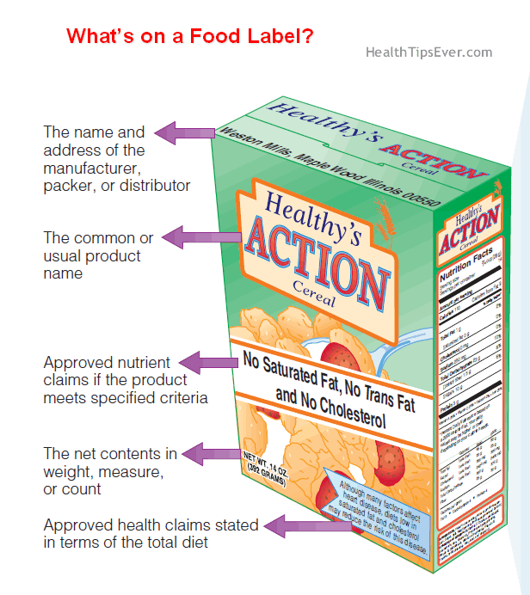
Project analysis slide 2
What’s on a Food Label
Nutrient Contents (Nutrition Facts panel
Essential warnings or allergy information
Ingredients (descending order by weight)

Slide 4
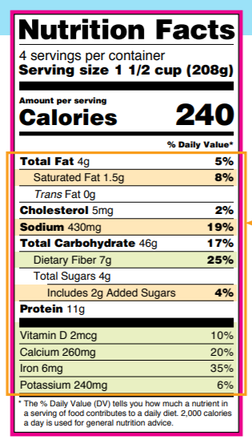
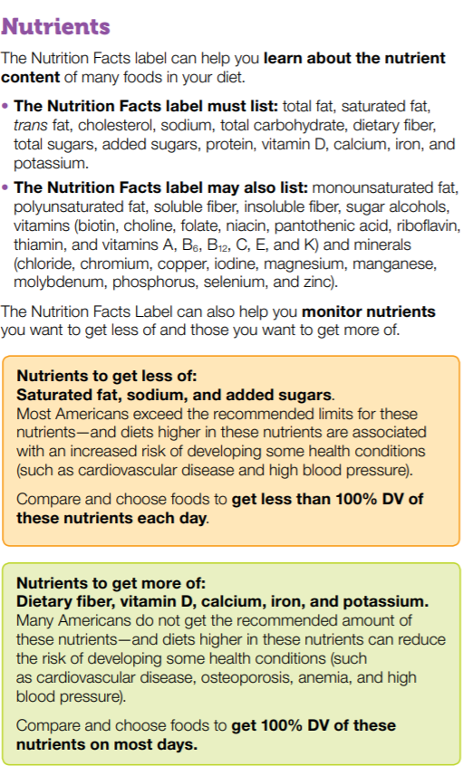
Project analysis slide 2
What’s on a Food Label

Slide 5
Project analysis slide 2
What’s on a Food Label
Components of Food Label
What the product is made of (reference INGREDIENT list)
Provides useful insight into:
Calories
Total Fat and type
Fiber
Vitamins/Minerals
Added sugar
Nutrient density: foods that provide the body with a lot of nutrients and relatively low in calories.
Useful tool to compare different products.
% Daily Value

Slide 6
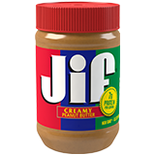
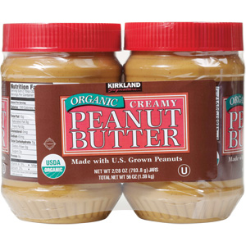
Project analysis slide 2
Ingredient List
VS.
Ingredients
Made From Roasted Peanuts And Sugar, Contains 2% Or Less Of: Molasses, Fully Hydrogenated Vegetable Oils (Rapeseed And Soybean), Mono And Diglycerides, Salt
Ingredients
Dry Roasted Organic Peanuts and sea salt.
Notes:
In addition to the Nutrition Facts label, the ingredient list is also a helpful tool. The ingredient list shows each ingredient in a food by its common or usual name. Ingredients are listed in descending order by weight, so the ingredient that weighs the most in the product is listed first, and the ingredient that weighs the least is listed last.

Slide 7
Project analysis slide 2
Where to start?
Look at serving size
Look at calories/serving size
40= low
100= moderate
400 or more=high
Limit saturated fat/trans fat, added sugars, and sodium
Get enough fiber and protein
1. Start here.
2. Calories
3. Carbs, fiber
4. Protein
Notes:
Size matters. Serving size is always the first item on the label. All other information is based on that serving size. The servings per container tell you know how many portions are in the whole box, package, or can. Beware: many packages contain more than one serving. Look at your orange juice for example. If the label says 125 calories per 8 ounce serving and your breakfast includes a 16 ounce glass of OJ, then you've taken in 250 calories from the juice alone. (About as many calories as you'd find in many chocolate bars.)
Look for fat: the good, the bad, and the really bad. Check the saturated fat and trans fat content of the food. For a general healthful diet, keep saturated fat and cholesterol low and avoid trans fats altogether. Look for foods that have 0 grams (g) of trans fat and are lowest in saturated fat and cholesterol. Try to stay away from foods that have the words "partially hydrogenated vegetable oil" in the ingredients list. Foods made with healthy unsaturated oils (olive, canola, safflower, etc.) are better bets.
Is it worth its salt? Compare the sodium content to the calories per serving. To keep your salt intake in check, consider products in which the sodium content is less than or equal to the calories per serving. For a food with 250 calories per serving, ideally the sodium content should be no more than 250 mg. If you need to seriously restrict your salt intake consider the low-sodium, low-salt, or unsalted versions.
Figure out the fiber. Aim for foods that have 5 g of fiber per serving, or at least one gram of fiber for every 10 grams of carbohydrate
Stay away from added sugars: Sugar, no matter what it's called, contains almost no nutrients other than pure carbohydrate. A heavy sugar intake fills you up with empty calories, keeps you from eating healthy foods, and stresses your body's ability to maintain a healthy blood sugar level. Steer clear of foods that have sugar, honey, molasses, corn syrup, corn sugar, fructose, or high-fructose corn syrup among the first three ingredients. Other names for sugar include agave nectar, brown sugar, cane sugar, corn sweetener, dextrose, maltose, fruit juice concentrate, and glucose.

Slide 8
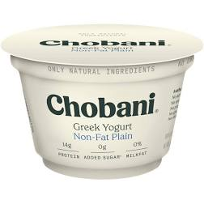
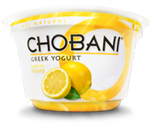
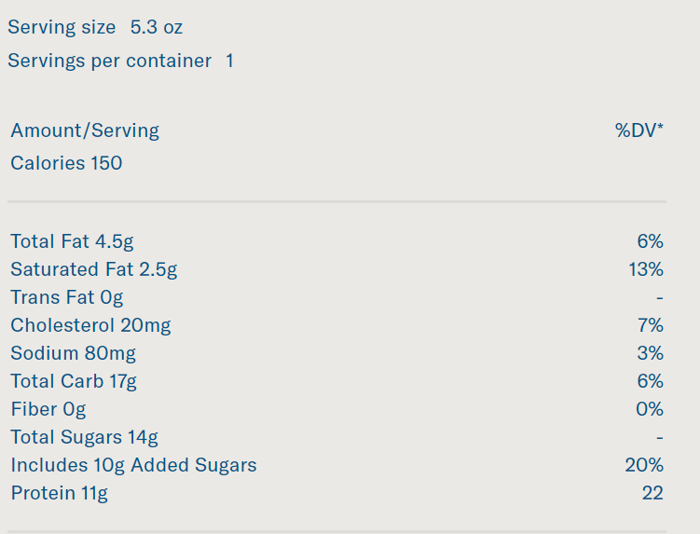
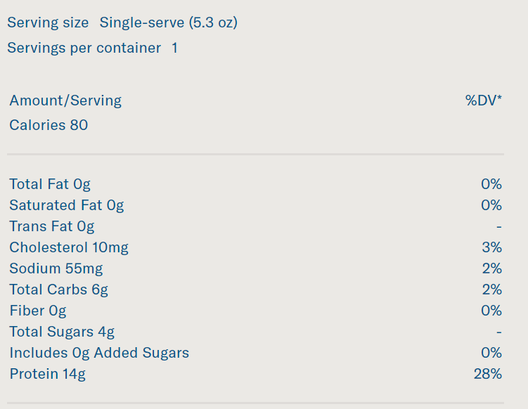
Project analysis slide 2
Making Informed Choices
VS.
Ingredients Cultured milk, cane sugar, lemon pulp, water, fruit pectin, lemon juice concentrate, natural flavors, locust bean gum.
Ingredients: Cultured Nonfat Milk

Slide 9
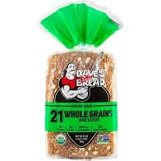
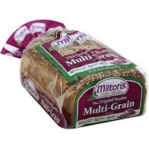
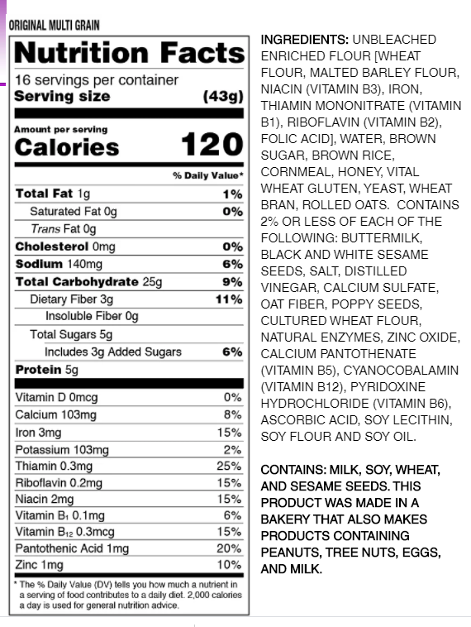
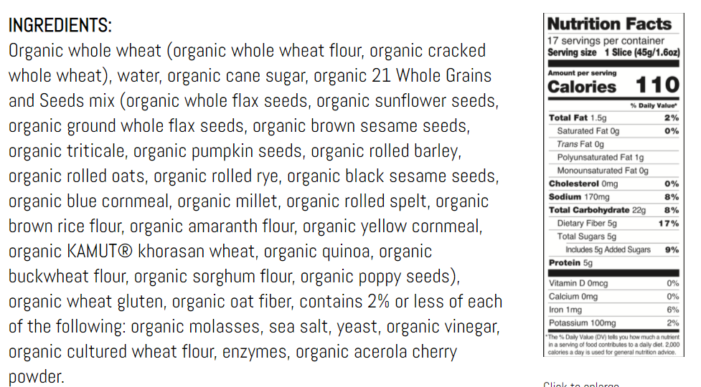
Project analysis slide 2
Making Informed Choices
VS.

Slide 10
Thank You

